Slide 1
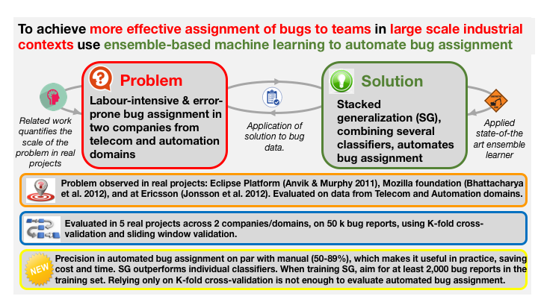
Notes:
Jonsson, Leif, et al. "Automated bug assignment: Ensemble-based machine learning in large scale industrial contexts." Empirical Software Engineering 21.4 (2016): 1533-1578.

